Slide 1



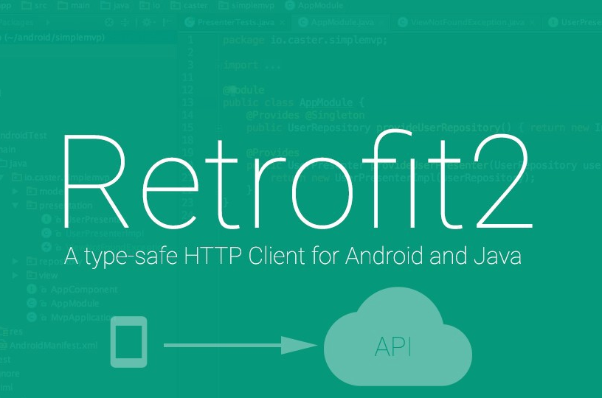

Room Booking System

Slide 2


TEAM
Name | Student Id
Tagore Kommineni | 1896534
Tanya Chawla | 1896508
Arshdeep Kaur | 1895974
Akhileshwar Reddy Naram | 1895748
Mahesh Reddy Sama | 1898496
Aditya Jigishkumar Purani | 1896493
Repository link :
https://github.com/tagorekommineni9/RoomBookingSystem

Slide 3
Introduction
Room Booking System is a modern digital booking system.
Room Booking system is an android application that enables Teachers, Pedagogical Counsellors as well as other Staff members in CEGEP’s Montreal campus to book a room either for an exam or a meeting.

Slide 4
Software Requirements
In our android project, we are using Java(JDK)1.8, MySQL 8.0 and Retrofit 2.0
MySQL for database.
Retrofit is the class through which the API interfaces are turned into callable objects.
PHP for the web calls.

Slide 5
First Week (May 4 – May 10) Software requirements documentation(Project report)
Description of project, Aim and Scope.
Functional requirements.
Non-Functional requirements.
Flow of the project using wire-frame tool (Justinmind).

Slide 6
Second Week (May 11 – May 18) Project report (To do)
Analysis models (use case diagram, class diagram).
ERD diagram.
Database SQL script.
Web calls.

Slide 7

THANK YOU

